Slide 1

Logistic Regression
Department of Computer Engineering and Applications
Gunjan Bharadwaj
Assistant Professor
Dept of CEA

Slide 2
Agenda
Classification
Introduction to Logistic Regression

Slide 3
Classification
The classification problem is just like the regression problem, except that the values we now want to predict take on only a small number of discrete values.
For now, we will focus on the binary classification problem in which y can take on only two values, 0 and 1.
For instance, if we are trying to build a spam classifier for email, then x(i) may be some features of a piece of email, and y may be 1 if it is a piece of spam mail, and 0 otherwise.
Hence, y∈{0,1}. 0 is also called the negative class, and 1 the positive class, and they are sometimes also denoted by the symbols “-” and “+.”
Given x(i), the corresponding y(i) is also called the label for the training example.

Slide 4
Logistic Regression Model
We could approach the classification problem ignoring the fact that y is discrete-valued, and use our old linear regression algorithm to try to predict y given x.
However, it is easy to construct examples where this method performs very poorly.

Slide 5
Hypothesis Representation
Hypothesis function: hθ​(x)
0≤hθ​(x)≤1
g(x)=1/(1+e^{−x})

Slide 6
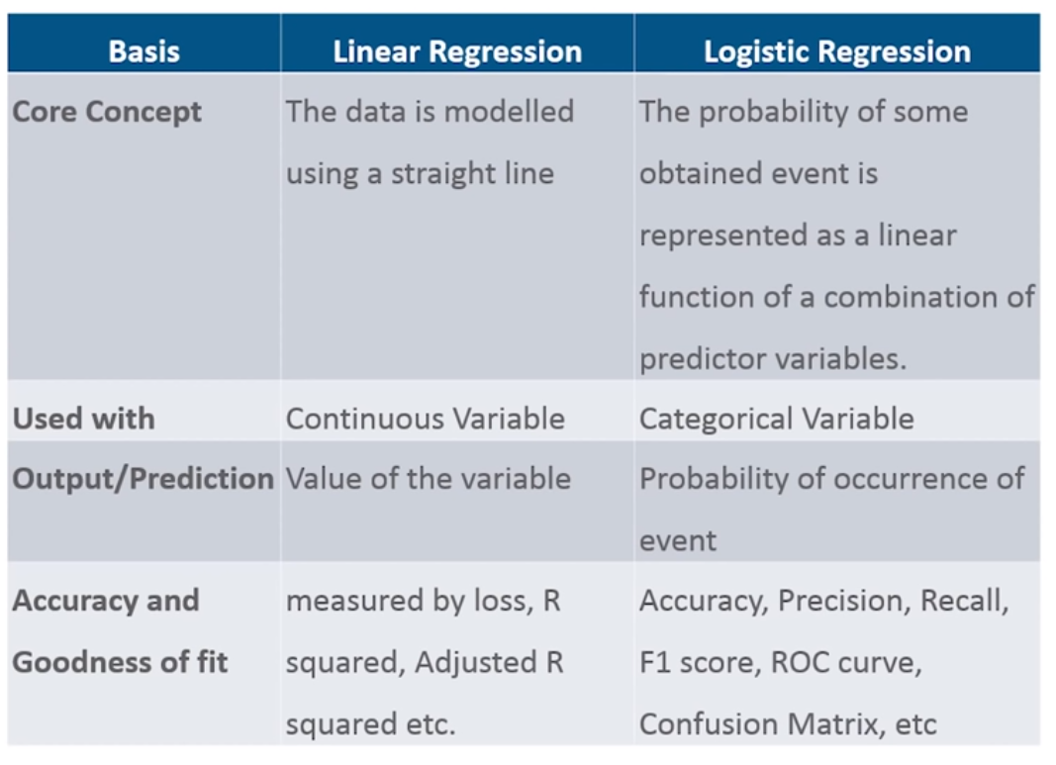
Linear vs Logistic Regression

Slide 7
Logistic Regression Model
Intuitively, it also doesn’t make sense for hθ​(x) to take values larger than 1 or smaller than 0 when we know that y ∈ {0, 1}.
To fix this, let’s change the form for our hypotheses hθ​(x) to satisfy eq 0≤hθ​(x)≤1. This is accomplished by plugging θ^{T}x into the Logistic Function.

Slide 8
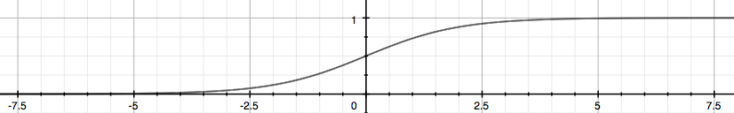
Logistic Function/Sigmoid Function
hθ(x) = g(θ^{T}x)
z = θ^{T}x
g(z)=1/(1+e^{−z})

Slide 9
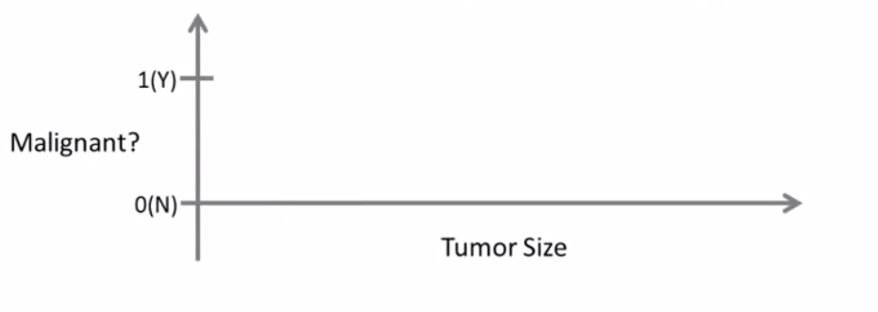
An Example
Let us consider a problem of finding the tumor being malignant or benign, Given the size of the tumor.

Slide 10
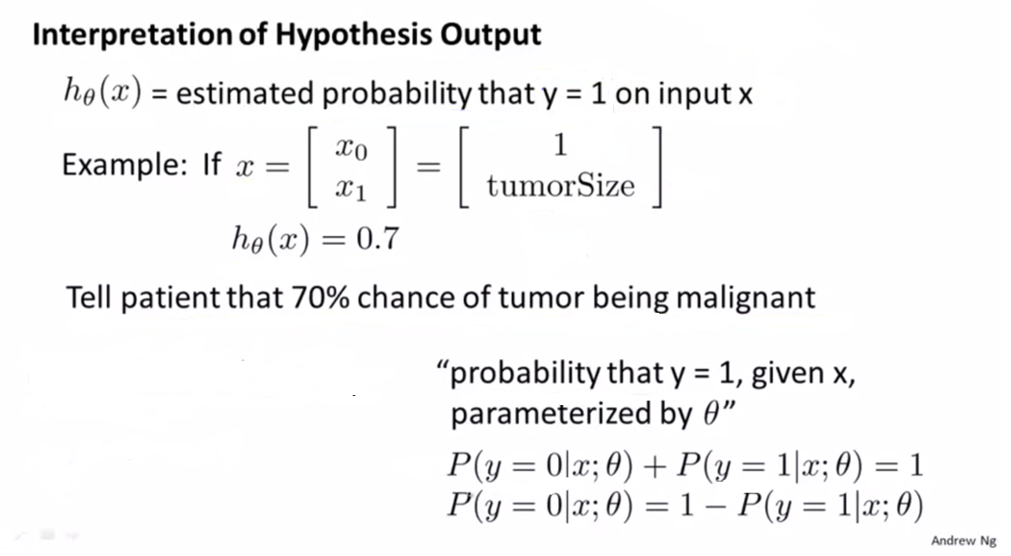
An Example

Slide 11
An Example

Slide 12
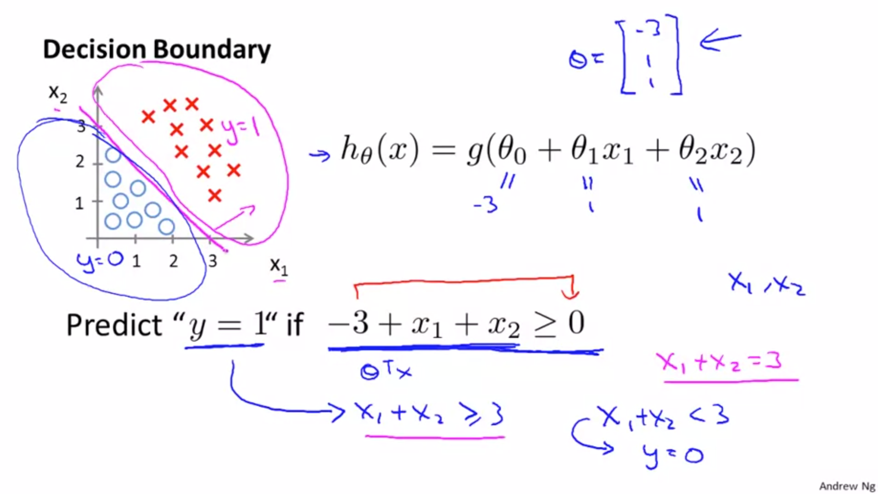

Slide 13
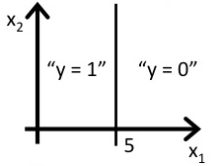
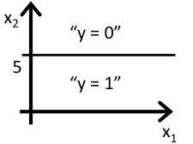
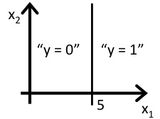
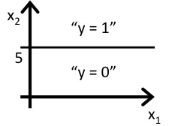
Problem
Consider logistic regression with two features x1​ and x2​. Suppose θ0​=5, θ1​=−1, θ2​=0, so that hθ​(x)=g(5−x1​). Which of these shows the decision boundary of hθ​(x)?

Slide 14
Cost Function
We cannot use the same cost function that we use for linear regression because the Logistic Function will cause the output to be wavy, causing many local optima. In other words, it will not be a convex function.

Slide 15
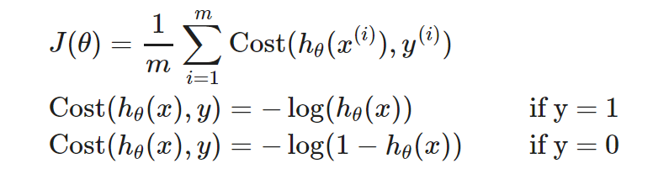
Cost Function

Slide 16
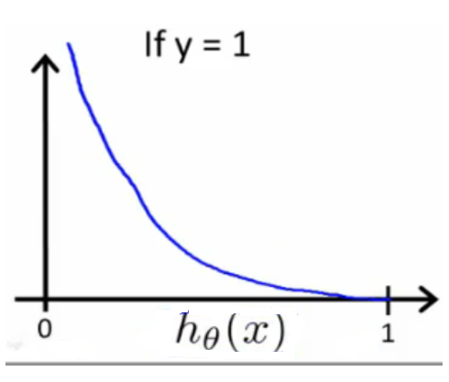
Cost Function
When y = 1, we get the following plot for J(θ) vs hθ​(x):

Slide 17
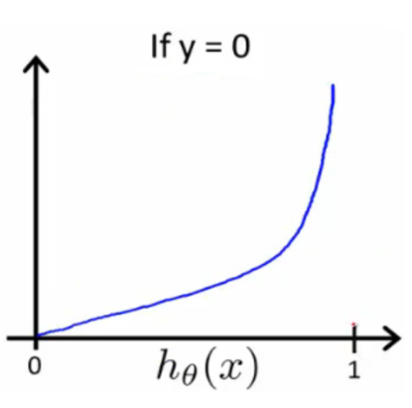
Cost Function
Similarly, when y = 0, we get the following plot for J(θ) vs hθ​(x):

Slide 18
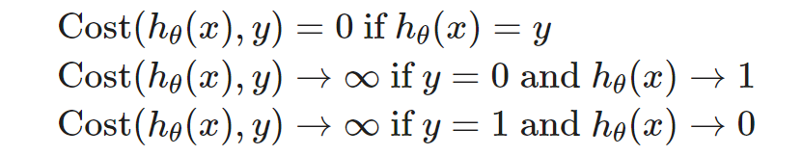
If our correct answer 'y' is 0, then
If our hypothesis function outputs 0, then the cost function will be 0.
If our hypothesis approaches 1, then the cost function will approach infinity.
If our correct answer 'y' is 1, then
the cost function will be 0 if our hypothesis function outputs 1.
If our hypothesis approaches 0, then the cost function will approach infinity.
Note that writing the cost function in this way guarantees that J(θ) is convex for logistic regression.

Slide 19
Problem
In logistic regression, the cost function for our hypothesis outputting (predicting) hθ​(x) on a training example that has label y∈{0,1} is:
cost(hθ​(x),y) = { −loghθ​(x) if y = 1
−log(1−hθ​(x))​ if y = 0​
Which of the following are true? Check all that apply.
a) If hθ​(x)=y, then cost(hθ​(x),y)=0 (for y=0 and y=1).
b) If y=0, then cost(hθ​(x),y)→∞ as hθ​(x)→1.
c) If y=0, then cost(hθ​(x),y)→∞ hθ​(x)→0.
d) Regardless of whether y=0 or y=1, if hθ​(x)=0.5, then cost(hθ​(x),y)>0.

Slide 20

Logistic Regression Cost Function
We can compress our cost function's two conditional cases into one case:

Slide 21

Logistic Regression Cost Function
We can write our cost function as follows:

Slide 22
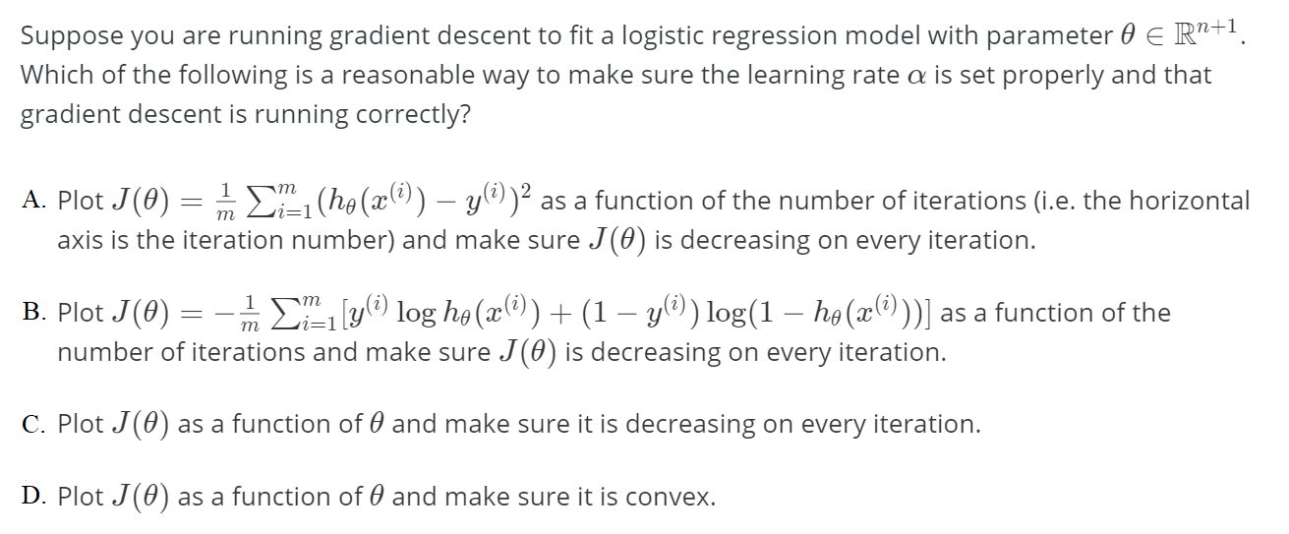
Problem

Slide 23
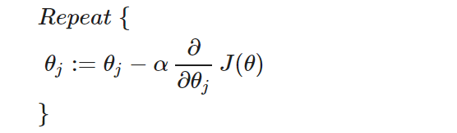
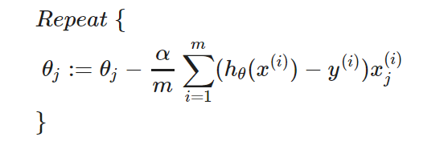
Gradient Descent
Remember the general form of gradient descent is:
We can work out the derivative part using calculus to get:

Slide 24
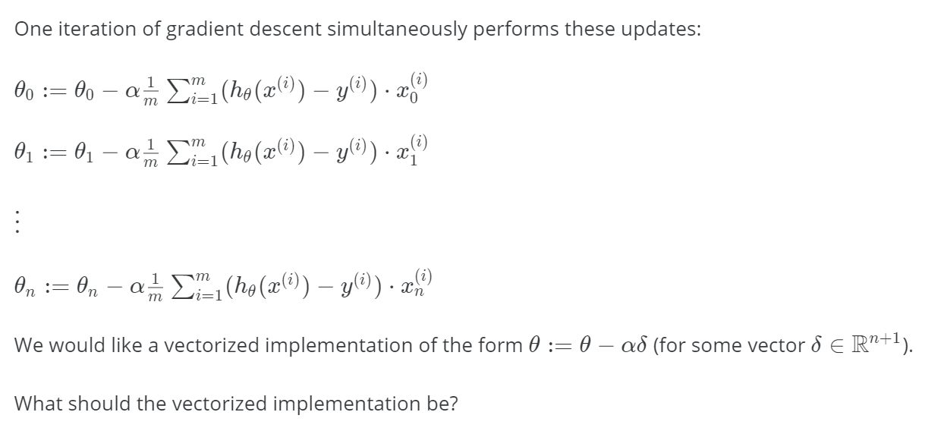
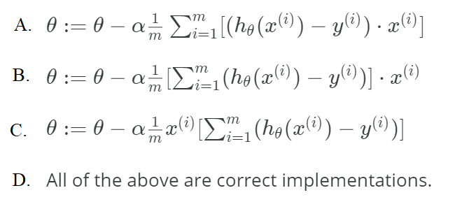

Slide 25
Thank You

